Slide 1

Aligning City Climate Plans with the SDGs in the Japan and the United Kingdom
Eric Zusman
Sustainability Governance Centre
ZeroCarbon x Digital: Urban Decarbonization in the Post-Covid-19 era

Slide 2
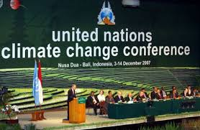

More than 10 years ago a re-orientation of climate change negotiations led to greater focus on cities

Slide 3








Cities are also featured in the SDGs
11.1 Housing and slum upgrading
11.2 Accessible transport system for all
11.3 Participatory and inclusive urbanization
11.4 World’s cultural and natural heritage protection
11.5 Protection of the poor and people in vulnerable situation
11.6 Capital environmental impact of cities reduction
11.7 Access to safe and inclusive public space
11.b.1 Implementation of mitigation and adaptation plans and policies
11.a.1 Urban-rural linkages
11.b.2 Countries with existing local disaster reduction strategy
11.c.1 Sustainable and resilient buildings

Slide 4
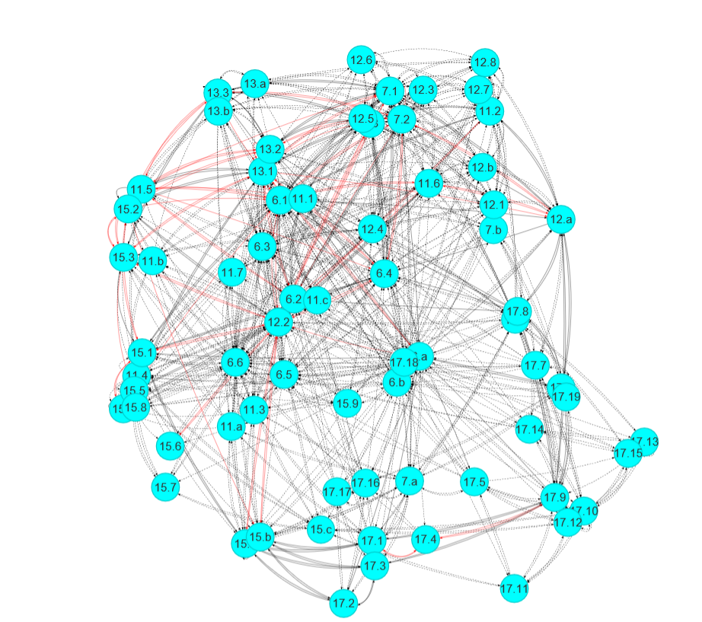




Many of the city goals are linked to other goals
Indonesia
Zhou and Moinuddin, 2018

Slide 5
Starting Point
There are potentially important synergies/trade-offs between climate and other development goals in cities
  Synergies: a city focused only on maximizing reductions in GHGs might also emphasize job creation, adequate housing, and helping an aging society etc.
  Trade-offs: a city focused on increasing accessibility might promote motorized transport and vehicle-centric lifestyles that increase GHGs
Realizing synergies and avoiding trade-offs will require integrating climate and other sustainability concerns into city plans

Slide 6
Multilevel Governance
1. Horizontal Coordination
Int Org Social Issues
Int Org Env Issues
Int Org Finance Issues
Ministry of Social Affairs
Ministry of Environment
Ministry of Finance
2. Vertical Coordination
Department of Social Affairs
Department of Environment
Department of Finance

Slide 7

Social Inclusion
1. Horizontal Coordination
Int Org Social Issues
Int Org Env Issues
Int Org Finance Issues
Ministry of Social Affairs
Ministry of Environment
Ministry of Finance
2. Vertical Coordination
Department of Social Affairs
Department of Env
Department of Finance

Slide 8

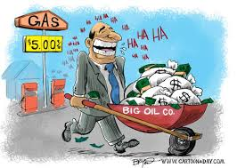

Vested Interests
1. Horizontal Coordination
Int Org Social Issues
Int Org Env Issues
Int Org Finance Issues
Ministry of Social Affairs
Ministry of Environment
Ministry of Finance
2. Vertical Coordination
Department of Social Affairs
Department of Env
Department of Finance

Slide 9
“A crisis is a terrible thing to waste”
Paul Romer, economist, Stanford University
Exogenous shock

Slide 10
Business as Usual Path
Institutional Barriers
Financial Barriers
Technological Barriers
Exogenous shock
Environmental Stress
Sustainable and Resilient Path
Time/Development

Slide 11
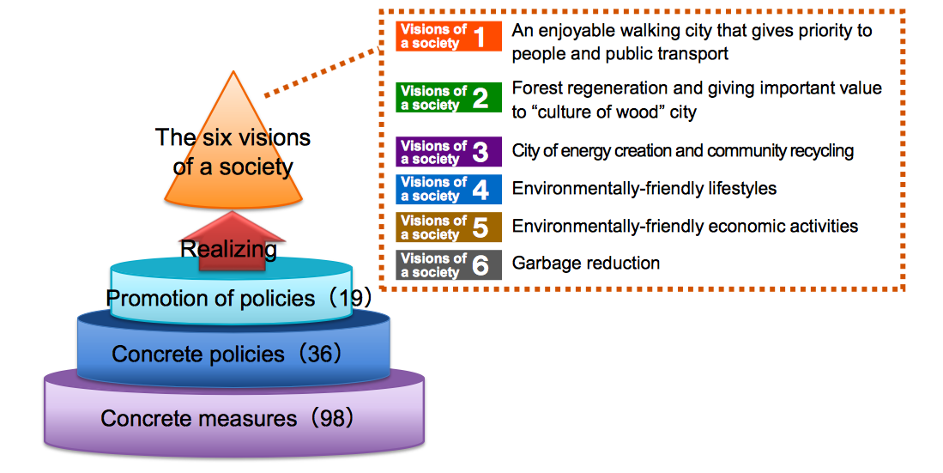
The Case of Kyoto: Sustainability Nexus
Environment
Social
Economic
Sustainability
98 Actions +
36 Policies +
19 Directions +
___________________
6 Visions for Low Carbon Society

Slide 12
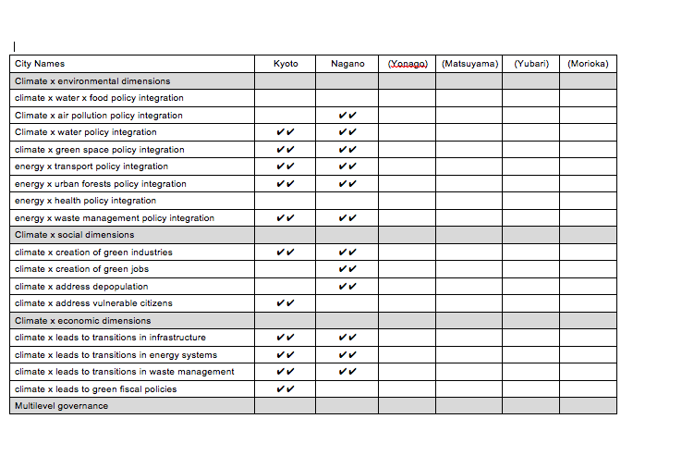
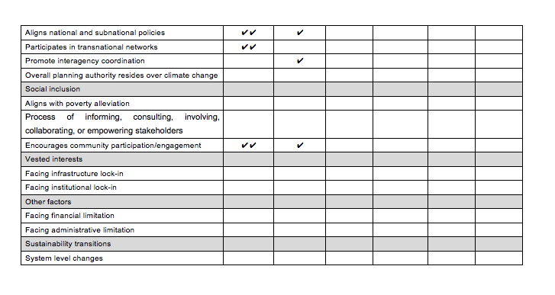
The Case of Kyoto
Multilevel Governance

Slide 13
The Case of Kyoto

Slide 14
Overall Findings
UK local authorities are legally obligated to “contribute to the mitigation of, and adaptation to, climate change”
However limited and mostly indirect links to sustainable development.
Compared to the UK, Japanese cities are more aware of climate-sustainable development links
But a systematic effort to build coherence between climate plans and the SDGs tends to be lacking in Japan as well.
Part of the challenge may be that interagency coordination and stakeholder engagement mechanisms within the city and multi-level governance beyond it need to be strengthened.

